Slide 1

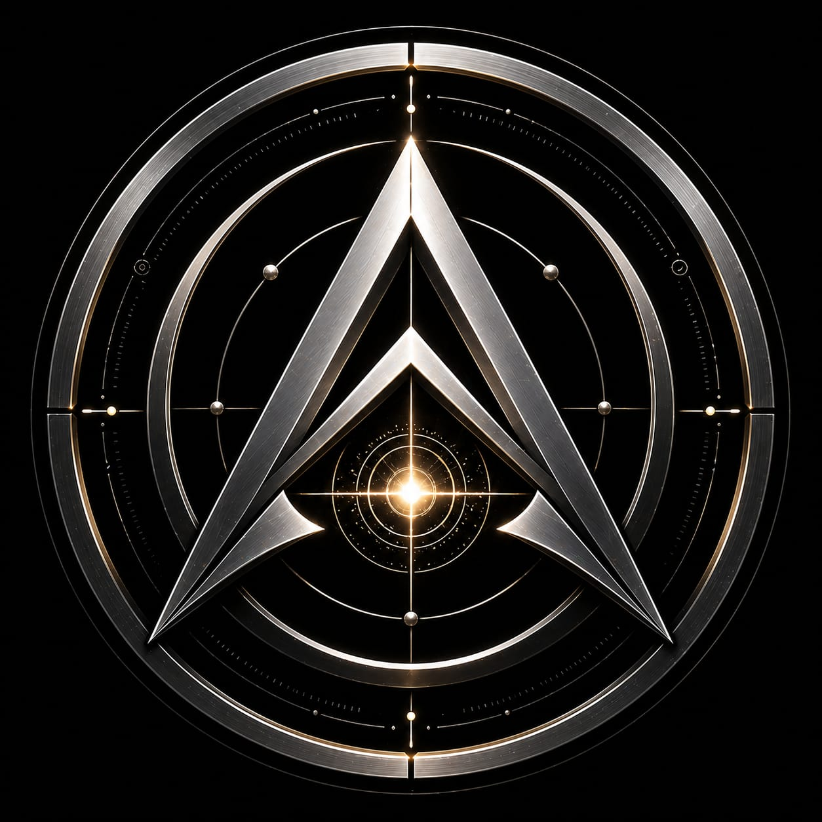
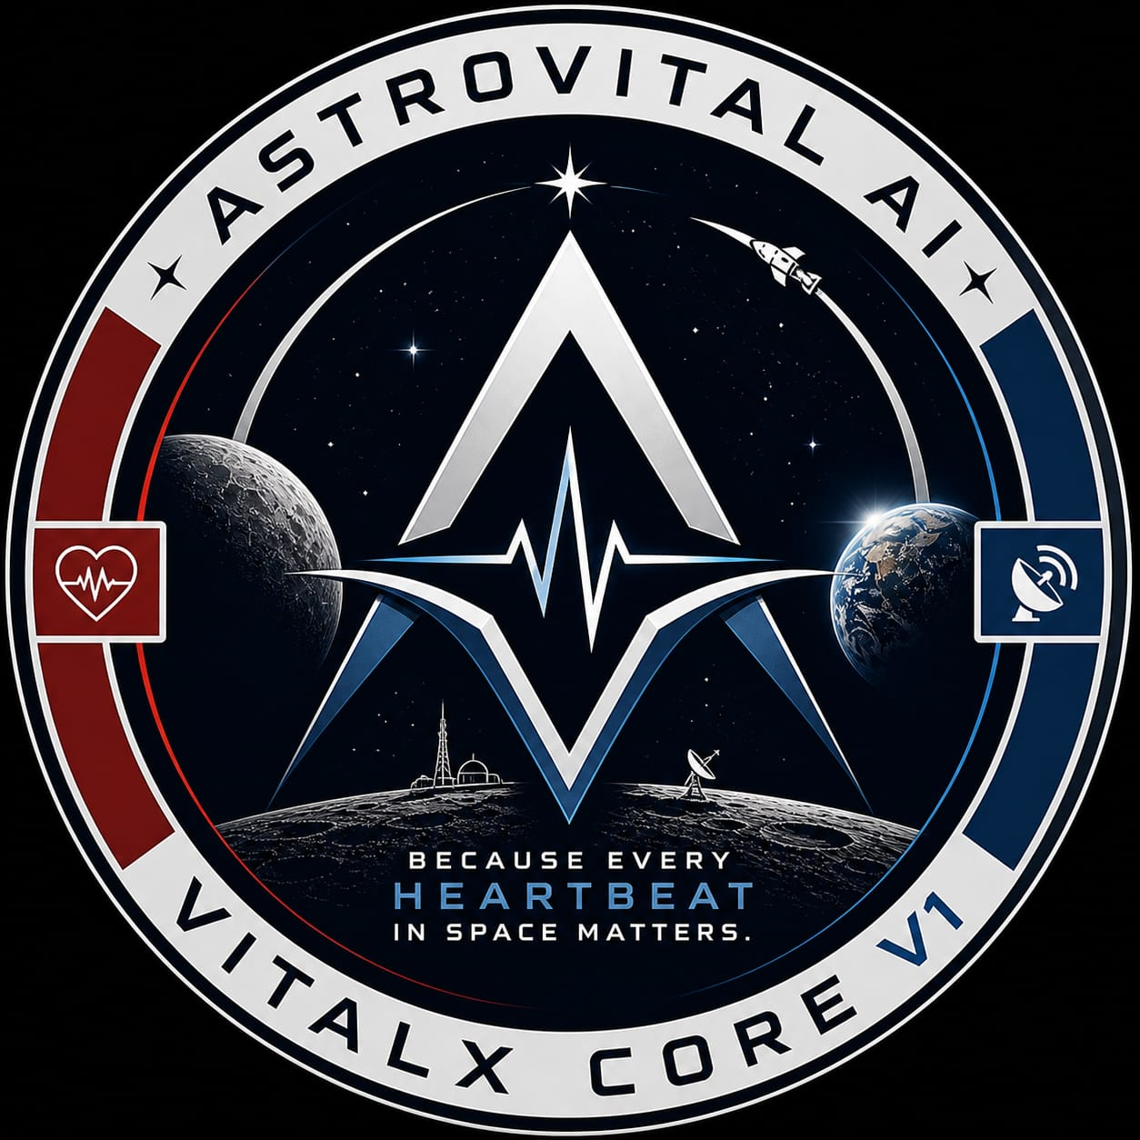
ASTROVITAL AI : VITALX CORE V1
EDGE-DEPLOYED CDSS FOR ASTRONAUT HEALTH MONITORING
© 2026 Gouragopal Mohapatra — All Rights Reserved
01

Slide 2
VITALX CORE V1
“Because Every Heartbeat In Space Matters.”
Developer – Gouragopal Mohapatra,
Independent Researcher
Date – May 2026
© 2026 Gouragopal Mohapatra — All Rights Reserved
02

Slide 3
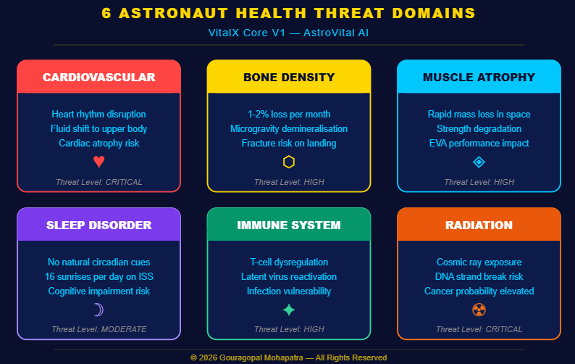
THE PROBLEM:
◆ Mars signal delay — 24 minutes one way
◆ 6 health threats — cardiovascular, bone, muscle, sleep, immune, radiation
◆ Current systems— reactive, not predictive
◆ No hospital exists in deep space
© 2026 Gouragopal Mohapatra — All Rights Reserved
03

Slide 4
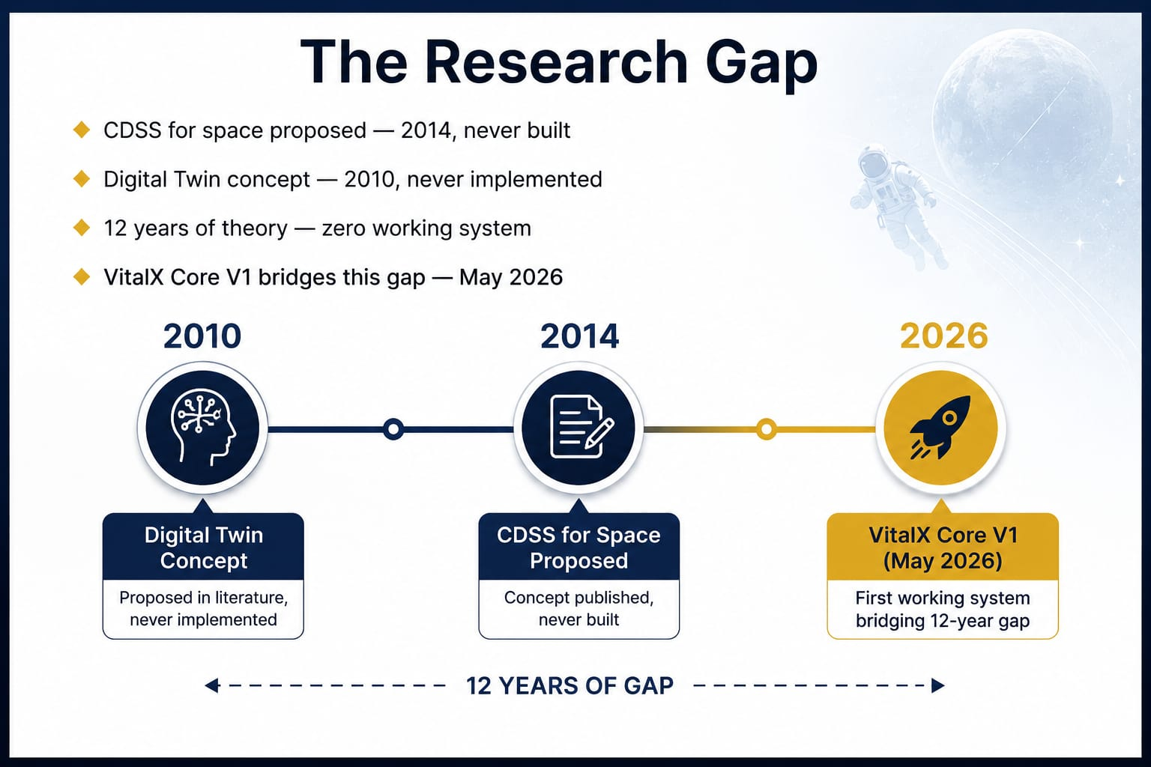
THE RESEARCH GAP:
◆ CDSS for space proposed — 2014, never built
◆Digital Twin concept — 2010, never implemented
◆12 years of theory — zero working system
◆ VITALX CORE V1 bridges this gap — May 2026
© 2026 Gouragopal Mohapatra — All Rights Reserved
04

Slide 5
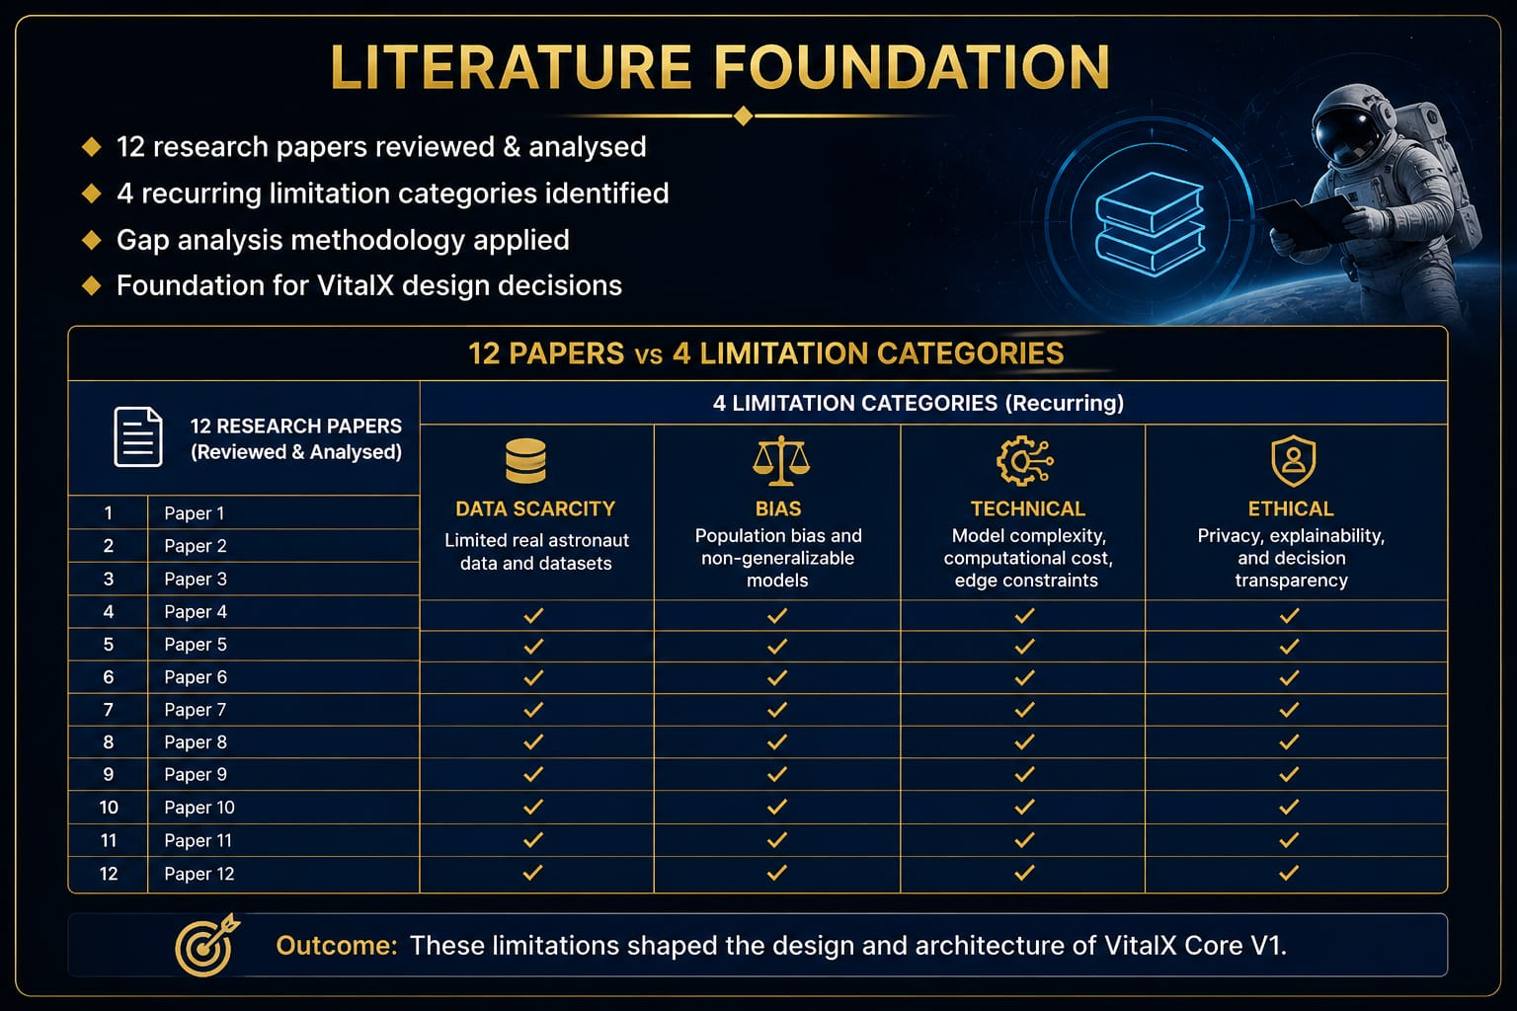
LITERATURE FOUNDATION:
◆ 12 research papers reviewed & analysed
◆ 4 recurring limitation categories identified
◆ Gap analysis methodology applied
◆ Foundation for VITALX design decisions
© 2026 Gouragopal Mohapatra — All Rights Reserved
05

Slide 6
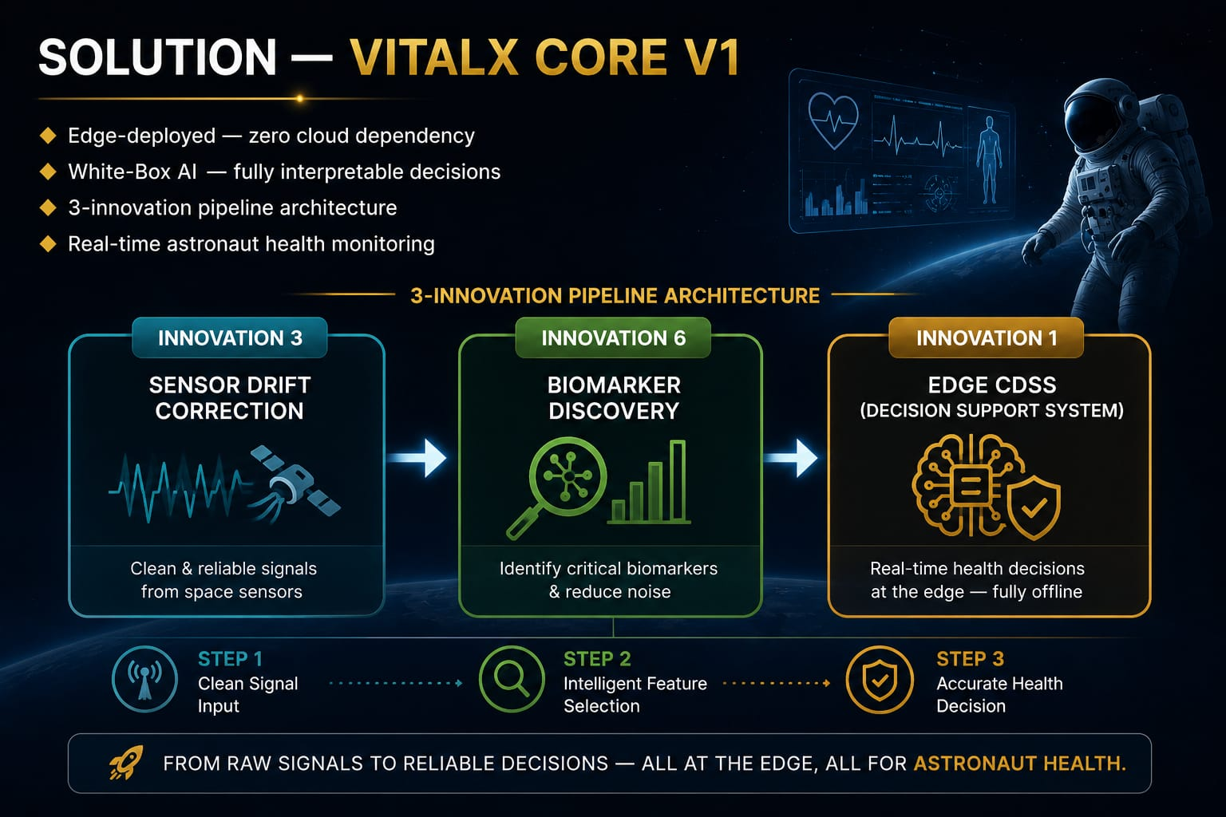
SOLUTION – VITALX CORE V1:
◆ Edge-deployed — zero cloud dependency
◆ White-Box AI — fully interpretable decisions
◆ 3-innovation pipeline architecture
◆ Real-time astronaut health monitoring
© 2026 Gouragopal Mohapatra — All Rights Reserved
06

Slide 7
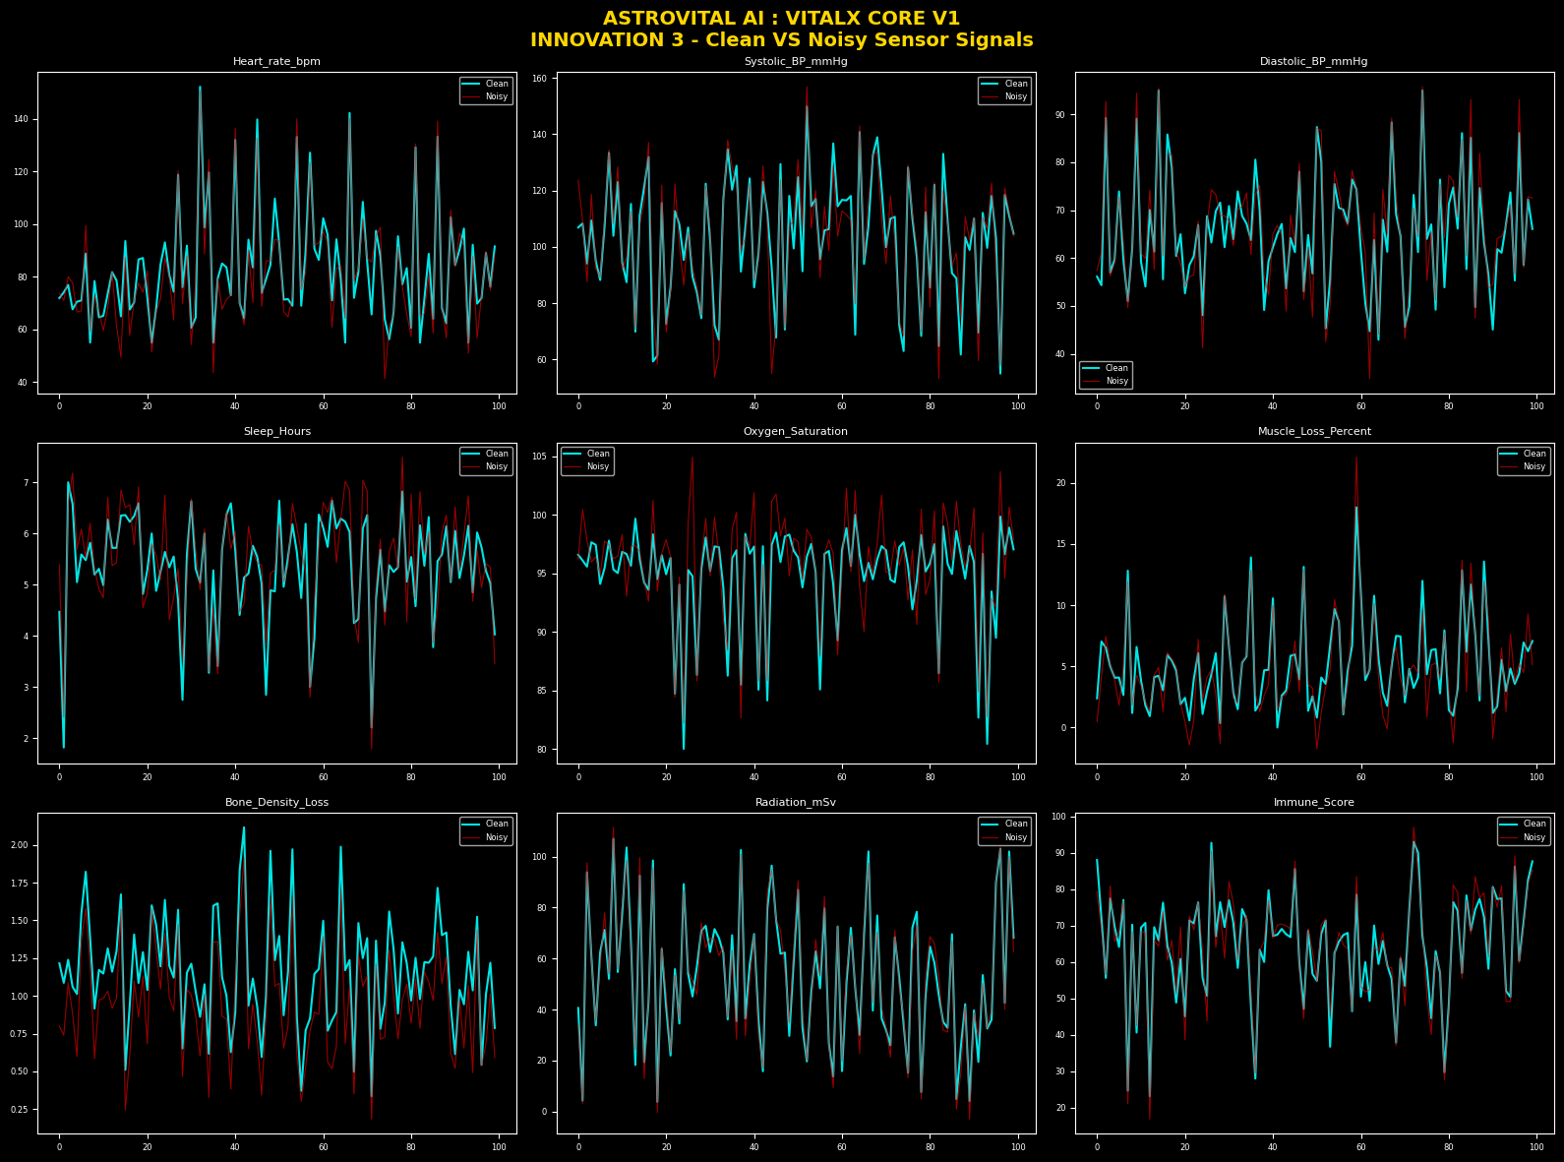
INNOVATION 3 – SENSOR DRIFT CORRECTION:
◆ Problem — sensors drift in microgravity
◆ Algorithm — Multivariate Regression + Random Forest
◆ Result — R² = 0.823 achieved
◆Clean signal restored for downstream processing
© 2026 Gouragopal Mohapatra — All Rights Reserved
07

Slide 8
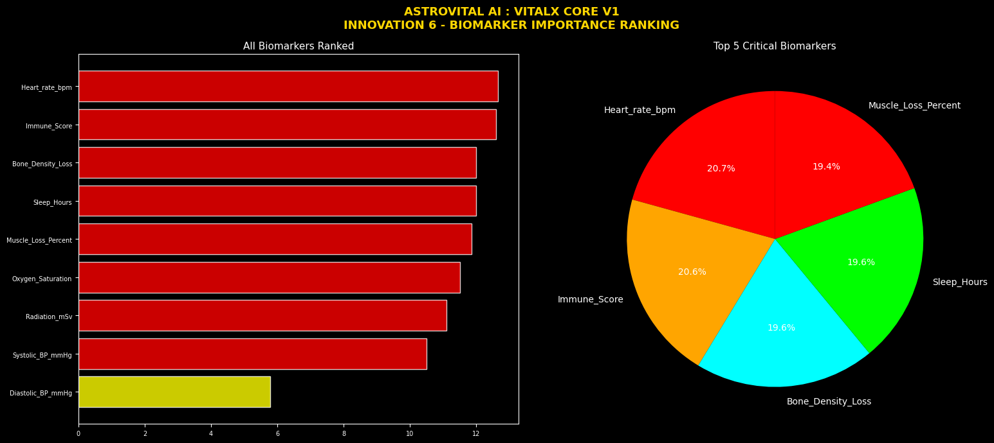
INNOVATION 6 – BIOMARKER DISCOVERY
◆ Random Forest feature importance used
◆ Top biomarkers for space health identified
◆ Reduces noise — focuses on critical signals
◆Feeds directly into Edge CDSS (Innovation 1)
© 2026 Gouragopal Mohapatra — All Rights Reserved
08

Slide 9
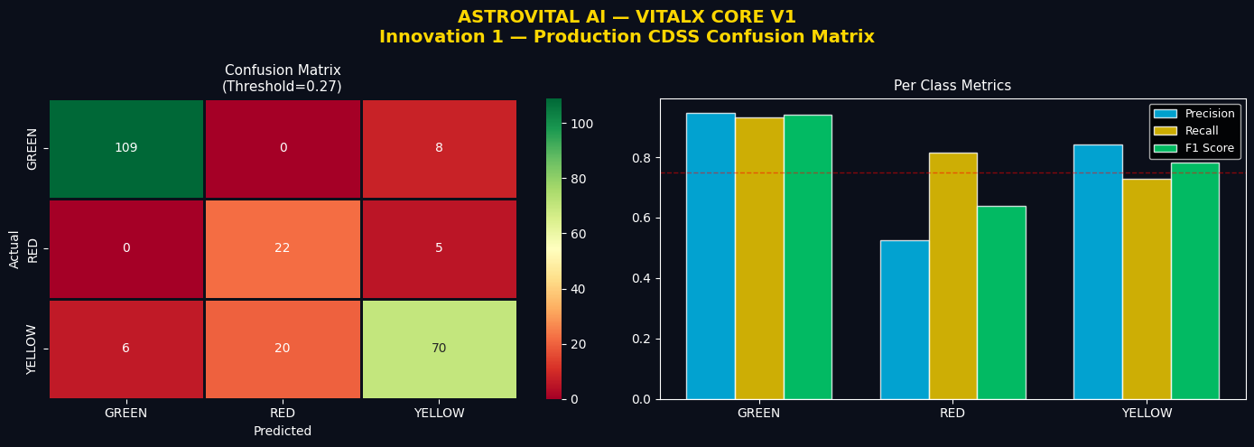
INNOVATION 1 – EDGE CDSS
◆ Algorithm — Decision Tree + Random Forest
◆ Threshold tuned to 0.27 for RED class
◆ RED recall improved — 10% → 81.48%
◆ No internet required — fully offline
© 2026 Gouragopal Mohapatra — All Rights Reserved
09

Slide 10
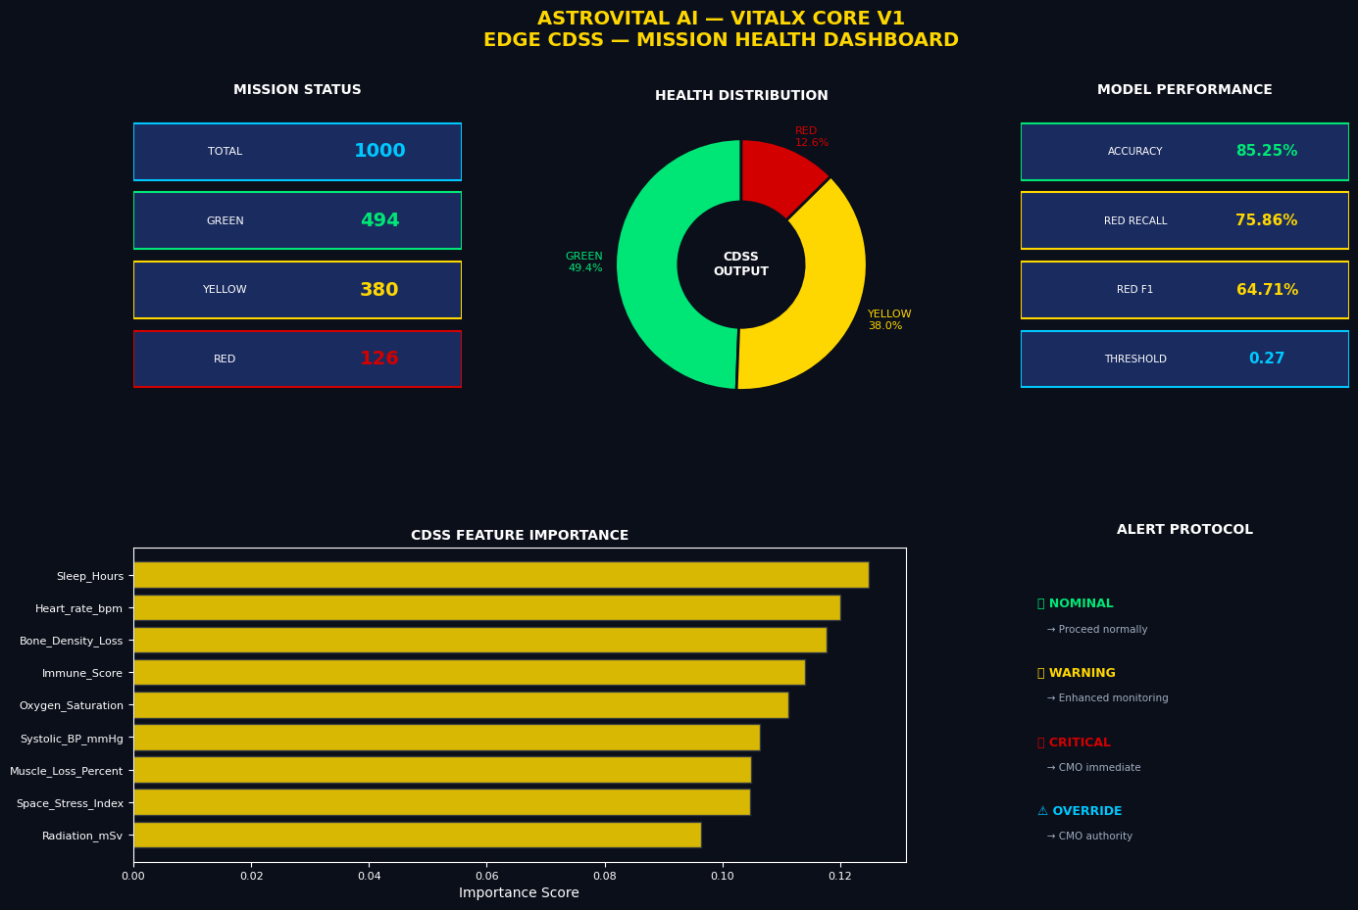
MODEL PERFORMANCE RESULTS:
◆Overall Accuracy — 85.25%
◆RED Class Recall — 81.48%
◆ Macro F1 Score — 78.65%
◆ Critical alerts — reliably detected
© 2026 Gouragopal Mohapatra — All Rights Reserved
10

Slide 11
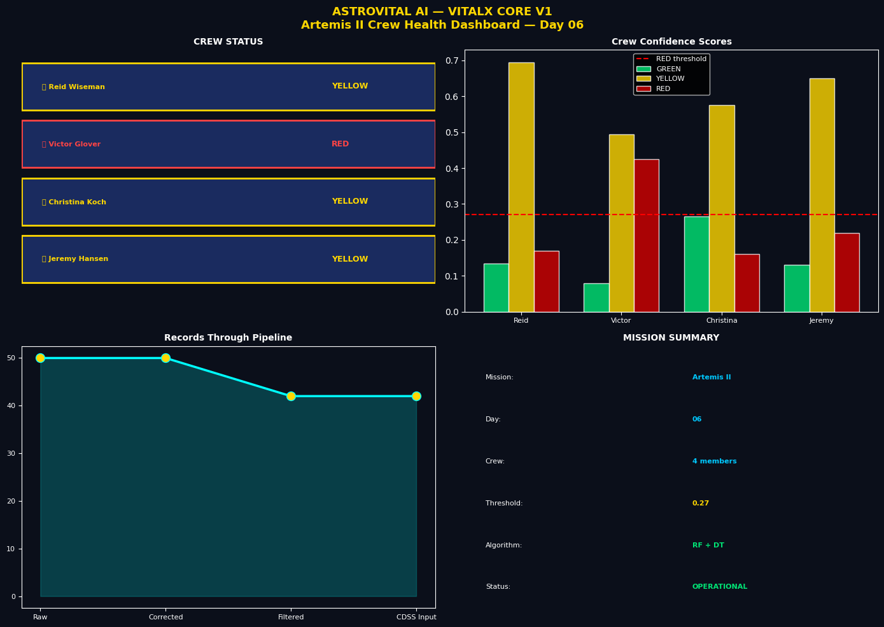
ARTEMIS II MISSION SIMULATION:
◆ 4 crew members simulated
◆ Real Artemis II mission scenario used
◆ CDSS generated live health decisions
◆System performed under mission conditions
© 2026 Gouragopal Mohapatra — All Rights Reserved
11

Slide 12
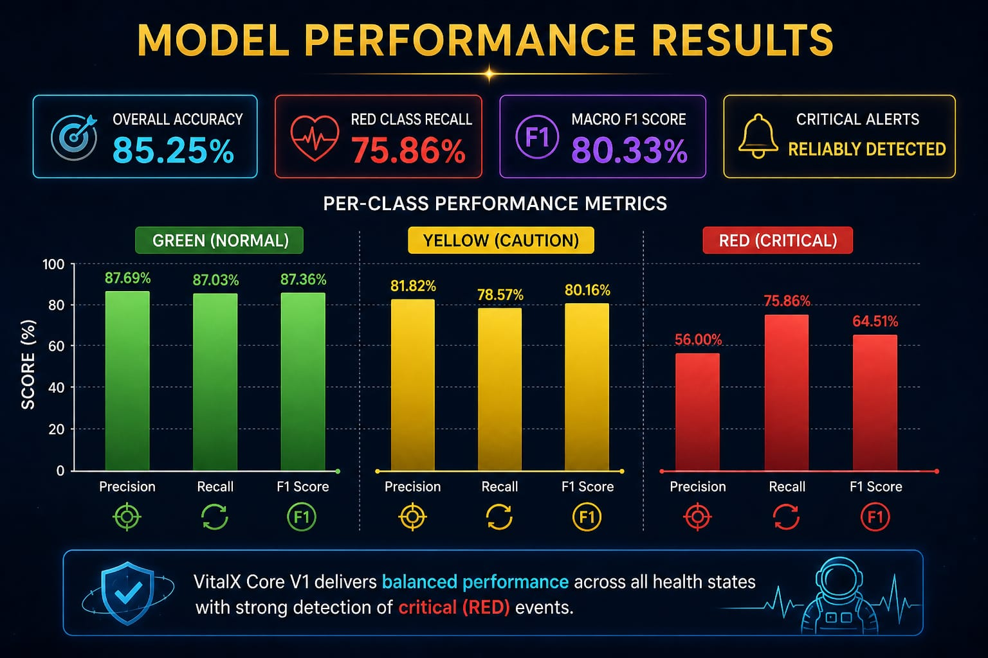
CURUNT LIMITATIONS:
◆ Dataset is synthetic — not real astronaut data
◆ RED class precision — 56% (needs improvement)
◆ Real sensor hardware not yet tested
◆ V1.5 (OMNISENITEL) & V2 (NeuralBeat) will address these gaps
© 2026 Gouragopal Mohapatra — All Rights Reserved
12

Slide 13
ASTROVITAL AI – MULTI VERSION ROADMAP:
ASTROVITAL AI
VITALX CORE V1
(EDGE CDSS)
AEREXIS OMEGA V1.5
(ICDSS – H & ICDSS – M)
OMNISENITEL V2
(DIGITAL TWIN)
NEURALBEAT V3
(RS & GNC)
© 2026 Gouragopal Mohapatra — All Rights Reserved
13

Slide 14
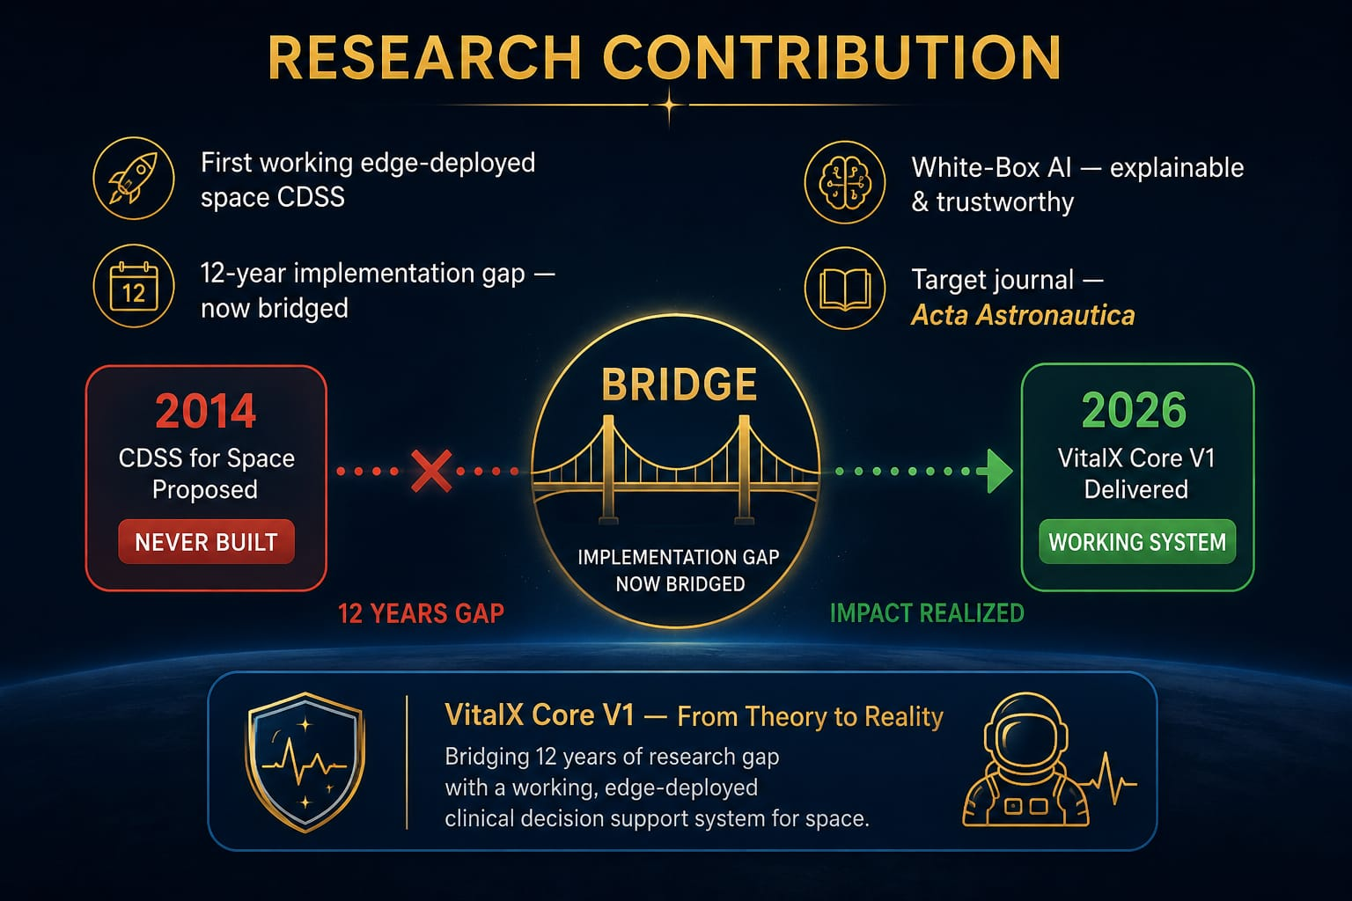
RESEARCH CONTRIBUTION:
◆ First working edge-deployed space CDSS
◆ 12-year implementation gap — now bridged
◆ White-Box AI — explainable & trustworthy
◆ Target journal — Acta Astronautica
© 2026 Gouragopal Mohapatra — All Rights Reserved
14

Slide 15
CONCLUSION:
◆ Problem — no predictive health system in space
◆ Solution — VITALX CORE V1, edge-deployed CDSS
◆ Result — 85.25% accuracy, RED recall 81.48%
◆ Mission — protect every astronaut, every heartbeat
© 2026 Gouragopal Mohapatra — All Rights Reserved
15

Slide 16
THANK YOU
◆ Because Every Heartbeat In Space Matters. ◆
◆ VITALX CORE V1 – THE 1ST PRODUCT OF ASTROVITAL AI ◆
◆ Developer: Gouragopal Mohapatra ◆
◆ © 2026 ASTROVITAL AI — All Rights Reserved ◆
© 2026 Gouragopal Mohapatra — All Rights Reserved
16

